Slide 1
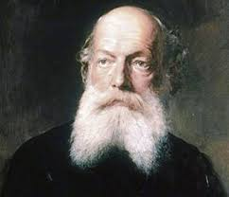
“If you want to become a chemist, you have to ruin your health. Who does not ruin his health by his studies, nowadays will not get anywhere in Chemistry”
-August Kekule (1890)

Slide 2
Chemical Management : Curriculum, Sensitization and Methodologies (in the Academe)
AILEEN MAY G. ANG, R.Ch.
Central Mindanao University
Musuan, Bukidnon, Philippines
Seminar on the Chemical Weapons Convention and Chemical
Safety and Security Management for Member States
of the OPCW in the Asia Region
Doha Regional Centre for CBRN Training, Doha, Qatar
4-6 February 2020

Slide 3
Objectives:
Understand the importance of chemical management in schools
Familiarize the components/framework of chemical management
Identify measures to make people realize the importance of chemical management
Determine steps how to put chemical management plan into action

Slide 4
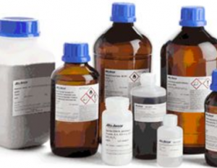
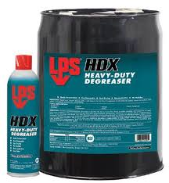
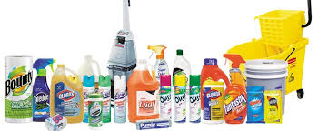
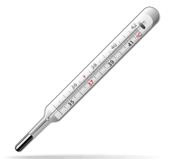
Are there dangerous chemicals in your school?
Laboratory chemicals
Inks, paints, and degreasers for industrial arts
Pesticides and Fertilizers
Maintenance Supplies
Healthcare Equipment
Source: EPA. 2006. Chemical Resource Management Guide for School Administrators.
www. Google.com (images)

Slide 5
Why chemical management should be a concern in schools?
Improper chemical management poses health and safety risks to students and school employees
Expenses incurred from disposal, spills, and other incidents

Slide 6
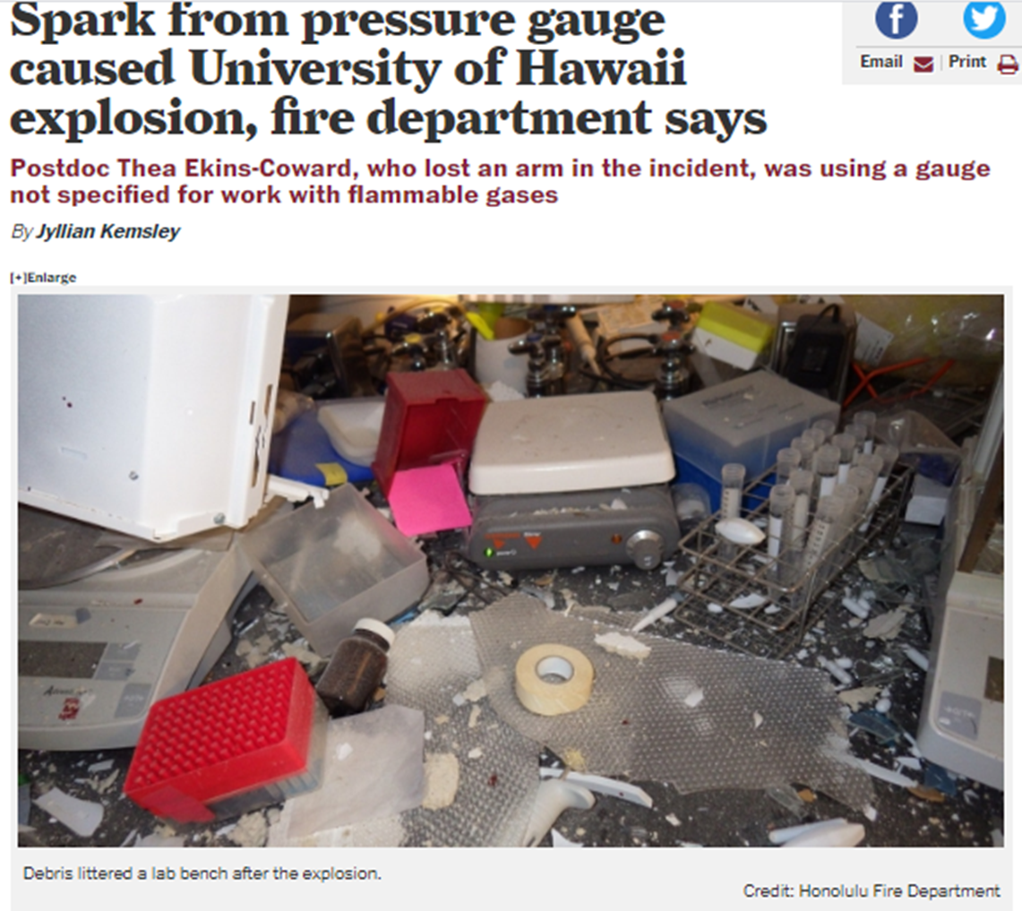
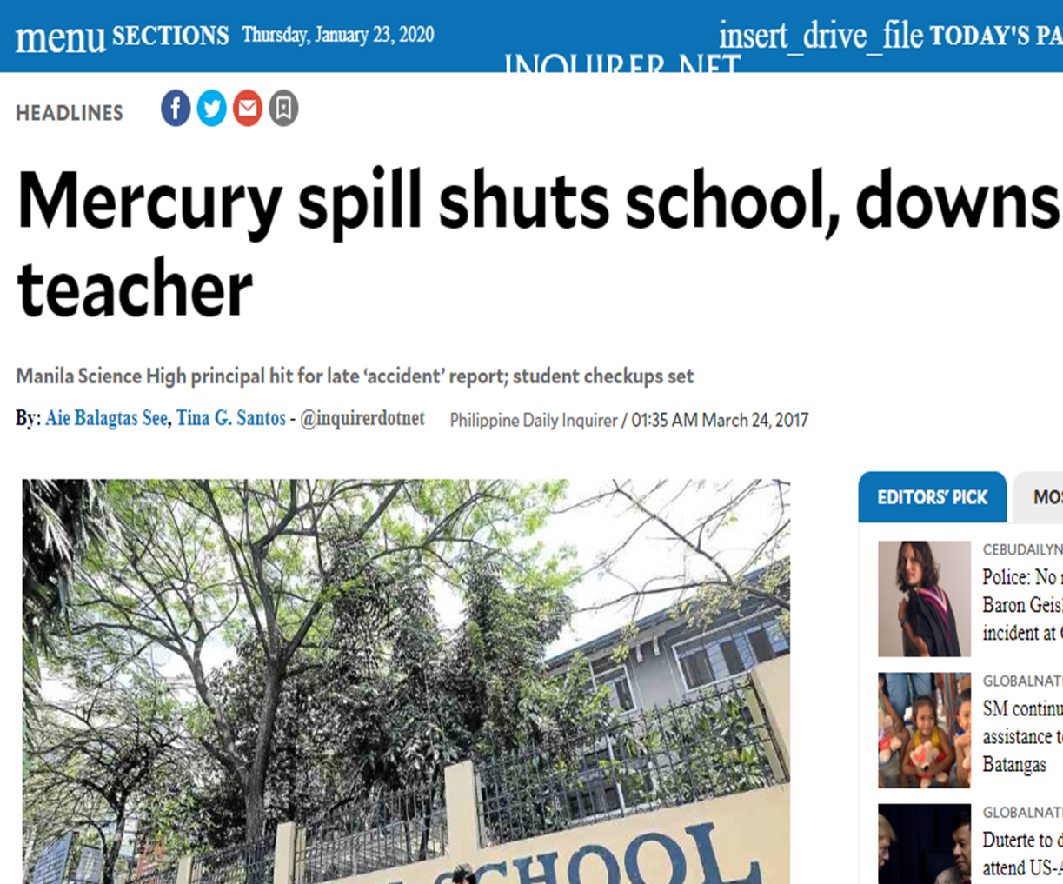
Why chemical management should be a concern in schools?
It only takes one chemical incident, such as a spill, explosion, or chemical exposure, to BREAK THE TRUST WITH THE COMMUNITY
Improper chemical management may result in school closures that result in a loss of valuable education time.

Slide 7
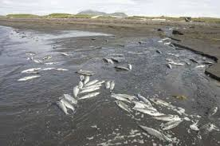
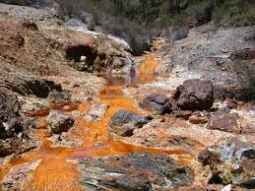
Why chemical management should be a concern in schools?
Improper chemical management can lead to unintended chemical discharges and spills, which inflict damage upon the environment

Slide 8
Chemical Management: Components
A
D
M
I
N
I
S
T
R
A
T
O
R
S
Chemical Procurement
Chemical Storage
Chemical Handling
Chemical Inventory
Transferring of Chemicals
Waste Disposal
What is the minimum amount of this chemical that is needed to perform the experiment? (When ordering chemicals, less is always best
Is the proper PPE available in the laboratory to handle this chemical?
What are the special handling precautions?
Where will the chemical be stored in the laboratory? Does the laboratory chemical hood provide proper ventilation?
Are there special containment considerations in the event of a spill, fire, or flood?
Will there be additional costs or considerations related to the disposal of this chemical?

Slide 9
Chemical Management: Components
A
D
M
I
N
I
S
T
R
A
T
I
O
N
Chemical Procurement
Chemical Storage
Chemical Handling
Chemical Inventory
Transferring of Chemicals
Waste Disposal
Before a substance is received, information on proper handling, storage, and disposal should be known to those who will be involved
No container should be accepted without an adequate identifying label
All substances should be received in a central location
Personnel should be trained to identify signs of breakage (e.g., rattling) and leakage (e.g., wet spot or stain) on shipments and such shipments should be refused or opened in a hood by laboratory staff

Slide 10
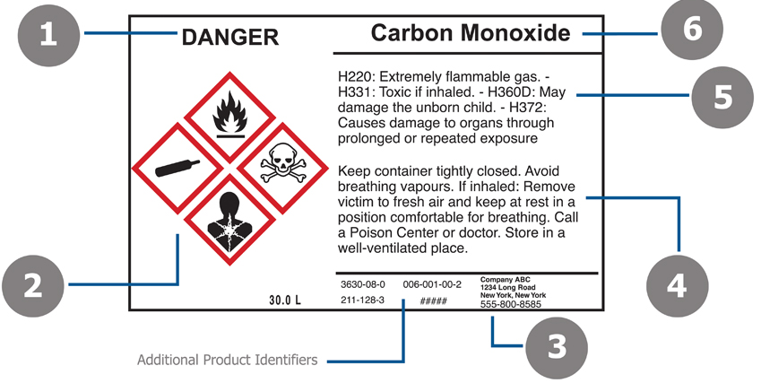
Chemical Management: Components
Laboratory personnel should separate and store all chemicals according to hazard category and compatibility
Laboratory personnel should read the MSDS and consider the precautions regarding the storage requirements of the chemicals in the laboratory
All chemical containers must be properly labeled with the full chemical name
Rooms used for chemical storage and handling should be controlled-access areas
Chemical Procurement
Chemical Storage
Chemical Handling
Chemical Inventory
Transferring of Chemicals
Waste Disposal

Slide 11
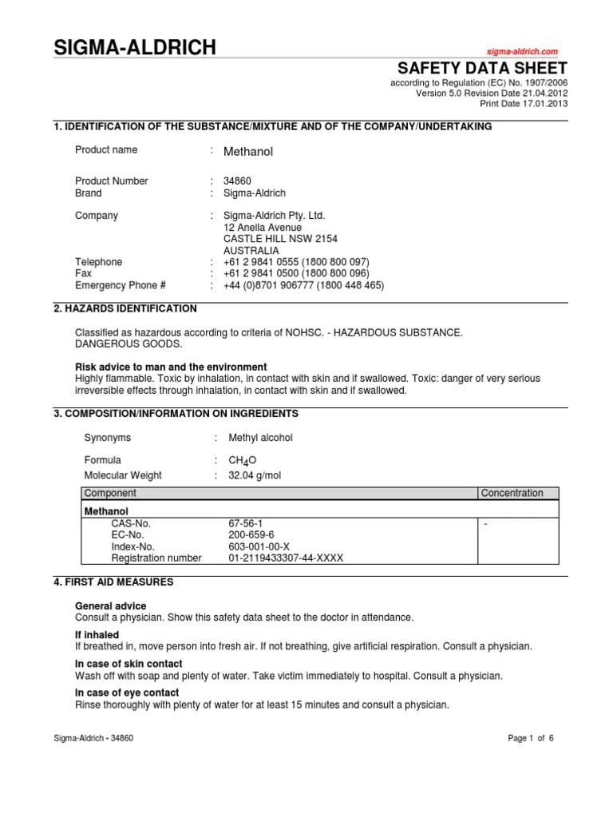
Chemical Management: Components
Chemical Procurement
Chemical Storage
Chemical Handling
Chemical Inventory
Transferring of Chemicals
Waste Disposal
comprehensive file of MSDS must be kept in the laboratory or be readily accessible online to all employees during all work shifts

Slide 12
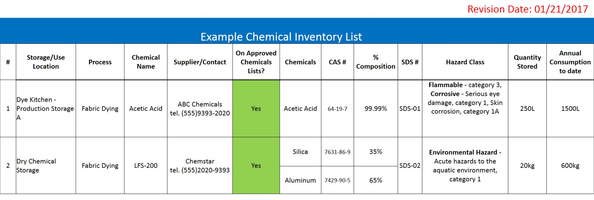
Chemical Management: Components
Chemical Procurement
Chemical Storage
Chemical Handling
Chemical Inventory
Transferring of Chemicals
Waste Disposal
Stored chemicals should be examined periodically (at least annually) for replacement, deterioration, and container integrity
Periodic inventories should be conducted, with unneeded items being discarded or returned to the storeroom/stockroom

Slide 13
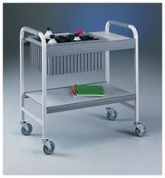
Chemical Management: Components
Chemical Procurement
Chemical Storage
Chemical Handling
Chemical Inventory
Transferring of Chemicals
Waste Disposal
use a secondary containment device or carts
Avoid high-traffic areas when moving chemicals within the building

Slide 14
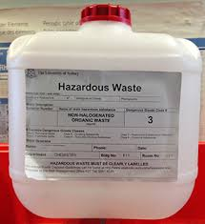
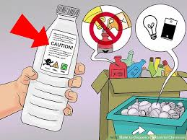
Chemical Management: Components
Chemical Procurement
Chemical Storage
Chemical Handling
Chemical Inventory
Transferring of Chemicals
Waste Disposal
All chemical waste must be stored and disposed of in compliance with applicable federal, state, local, and institutional regulatory requirements
Waste containers should be properly labeled

Slide 15
Chemical Management: Sensitization
Recommendations:
Improve the culture of safety ethics and risk management among the university staff and students by establishing an Environmental Health and Safety Office
Develop a course on hazardous waste and risk management, to be made compulsory for all university students
Significant Findings:
levels of awareness ranged between fair to good for the majority of assessment criteria
students have shown poor attitude towards safety in chemical laboratories
weakness on how staff deal with specific emergency incidents

Slide 16
Chemical Management: Sensitization
Publicize Chemical Management Program/Plan
Develop and Deliver Effective Message/Slogan
Integrate Chemical Management in the Course or Program Curriculum
Identify Target Audiences and hold awareness seminar
Use existing communication channel to publicize program
Update the technical “know-how” of the faculty and staff

Slide 17
Chemical Management: Sensitization
Publicize Chemical Management Program/Plan
Develop and Deliver Effective Message/Slogan
Sample Slogans:
Rehab the Lab!
Safer School…. Healthy School!
Safer Schools Initiative”
develop a message that is distinctive, clear, simple, and compelling
develop a catchy program name or slogan -- help your program make a memorable splash and maintain interest

Slide 18
Chemical Management: Sensitization
Publicize Chemical Management Program/Plan
Identify Target Audiences and hold awareness seminar
Tailoring your central message to each target audience increases your chances of gaining support for your program
think about which program components should be emphasized
Target Audience | Program Component | Sample “Hot” Topic
Administrator | Purchasing, Storage, Inventory, Use, Disposal | Liability and Budget
Faculty and Staff | Storage, Inventory, Use, Disposal | Classroom safety, curriculum, and professional responsibility
Students | Storage, Use, Disposal | Danger Imposed by Chemicals and Safety Measures
Parents | Storage, Disposal | Their Children’s Health

Slide 19
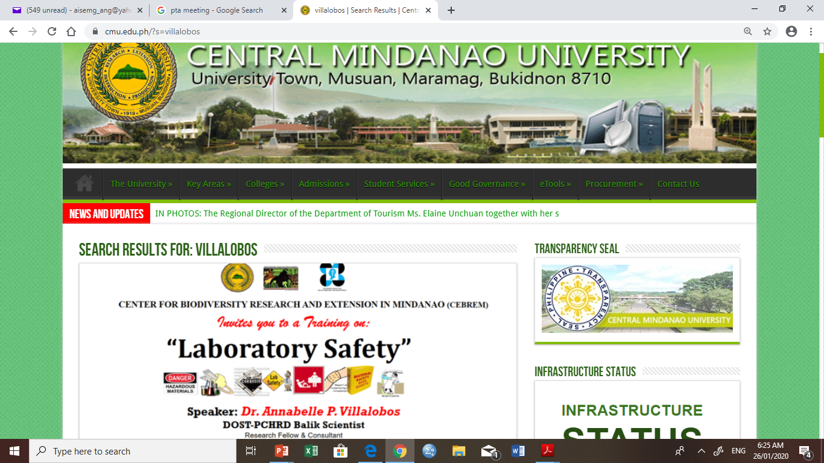
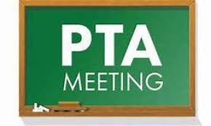
Chemical Management: Sensitization
Publicize Chemical Management Program/Plan
Use existing communication channel to publicize program
use existing approaches and products
No need to reinvent the “wheel”

Slide 20
Chemical Management: Sensitization
Publicize Chemical Management Program/Plan
CONSIDER THE MOST EFFECTIVE TIME OF YEAR TO PERFORM COMMUNICATION AND PUBLICITY EFFORTS
“Timing is everything”
Pick a time that will optimize participation, funding, and results
A chemical inventory or cleanout might be safer if it is carried out during summer months when fewer students, teachers, and staff are present
Stakeholders may be more receptive near the beginning of the school year when students are settled and ‘back-to-school’ is still on the public’s mind

Slide 21
Chemical Management: Sensitization
Update the technical “know-how” of the faculty and staff
budget for seminars and trainings (e.g. annual faculty conference)
“Capacity building”
Integrate chemical management in the course curriculum

Slide 22
Chemical Management: Sensitization
Integrate chemical management in the course curriculum

Slide 23
Chemical Management: Methodologies
A. Create an institutional safety and security committee and appoint chemical safety and security officers
Chemical safety
Chemical inventory
First aid
Emergency Measures
Chemical Security
Chemical Waste Disposal
B. Evaluate current chemical management practices
Conduct a visual tour to get first impressions of chemical management situation, policies, and practices

Slide 24
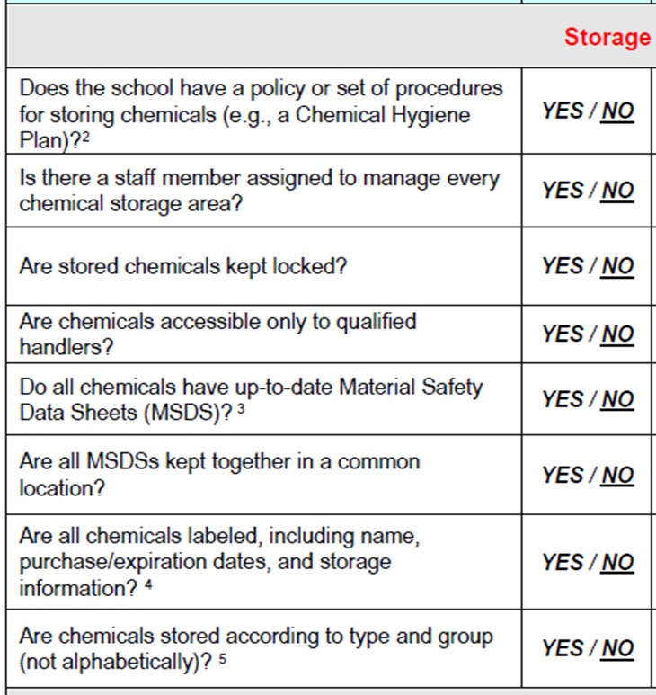
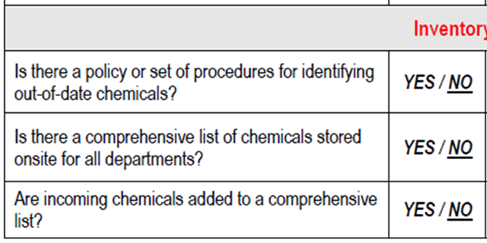
Chemical Management: Methodologies
B. Evaluate current chemical management practices
Perform a comprehensive evaluation of chemical management situation, policies, and procedures
Storage
Inventory
Purchasing

Slide 25
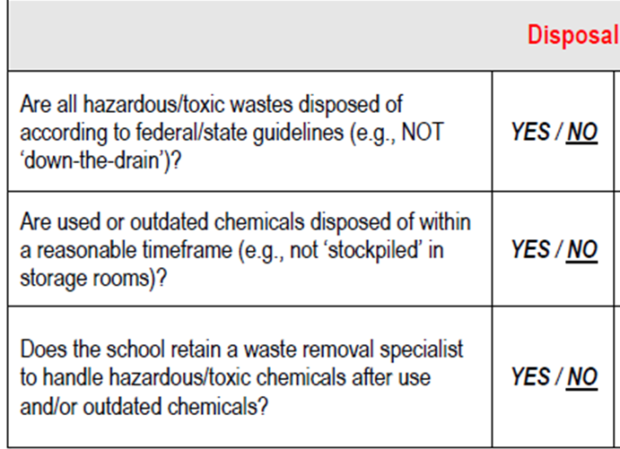
Chemical Management: Methodologies
B. Evaluate current chemical management practices
Perform a comprehensive evaluation of chemical management situation, policies, and procedures
Use
Disposal

Slide 26
Chemical Management: Methodologies
C. Develop a safety and security policy statement and implement administrative controls or modify existing chemical management procedures
define, document, and endorse a chemical safety and security management system
Implement institution’s rules and procedures and establish the responsibilities of individuals
Controls (general safety rules, laboratory housekeeping procedures, waste disposal etc.)
E. Train appropriate groups on responsible chemical management
ALL that is involved in the school chemical management aspect are all candidates for the training
administrators
faculty
staff
Parents
Students

Slide 27
Chemical Management: Methodologies
E. Train appropriate groups on responsible chemical management

Slide 28
Chemical Management: Methodologies
F. Perform an inventory of all chemicals and chemical products
Chemical inventory include:
Chemical or product name
Place(s) where material is being stored (room, name, building);
Program(s) using the material and whether it is currently being used
Date of purchase
Amount of material currently in school (by location).
Important to:
making responsible purchasing decisions
considering safe storage arrangements
evaluating use
estimating removal and disposal cost

Slide 29
Chemical Management: Methodologies
F. Perform an inventory of all chemicals and chemical products

Slide 30
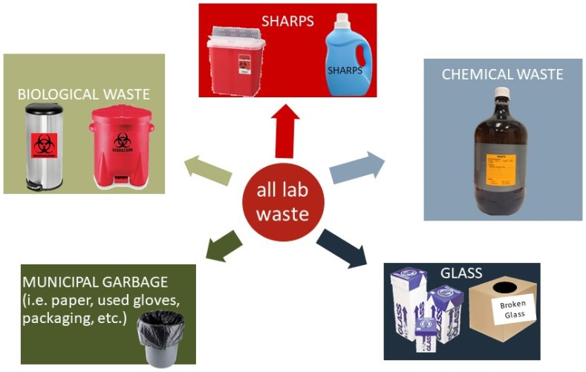
Chemical Management: Methodologies
G. Segregate waste properly and secure a chemical cleanout professional
Evaluate your chemical inventory and create a list of chemicals to dispose (a disposal list)
Identify a qualified professional(s) to assist in the cleanout and disposal process (Third party)
Segregate waste properly as indicated in the Safety Manual and Laboratory Manual and during class orientation

Slide 31
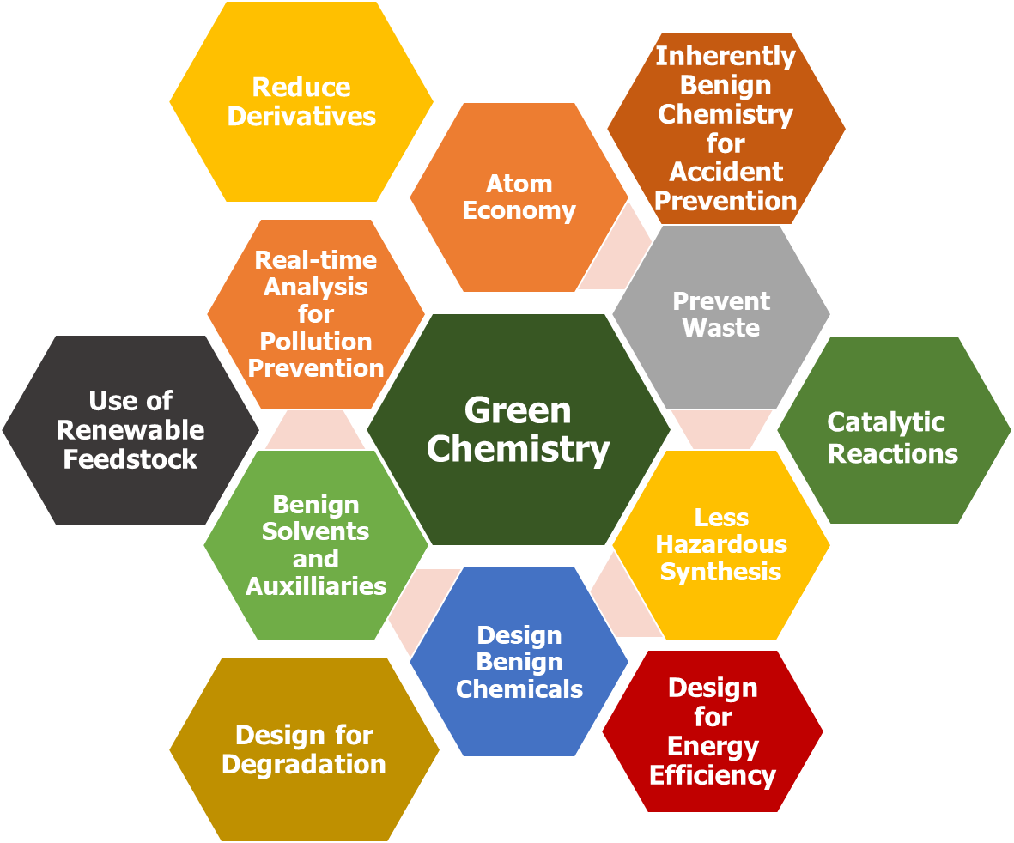
Chemical Management: Methodologies
H. Implement a “green” curriculum: Green Chemistry for Every Laboratory
Green Chemistry philosohy of designing products and processes that reduce or eliminate the use and generation of hazardous substances
Reducing chemicals in the school’s operational aspect (janitorial/sanitation)
Apply 12 principles of green chemistry for prudent experiment design and execution

Slide 32
Chemical Management: Methodologies
H. Implement a “green” curriculum: Green Chemistry for Every Laboratory

Slide 33
H. Implement a “green” curriculum: Green Chemistry for Every Laboratory
Design for energy efficiency
Heating Device | Time (min) | Energy Consumed (KJ) | Energy Saved (KJ)
Microwave Oven | 2 | 51 | 75.0%
Hot Plate | 14 | 288

Slide 34
H. Implement a “green” curriculum: Green Chemistry for Every Laboratory
Less Hazardous Chemical Synthesis/ Benign solvent for natural products Extraction

Slide 35
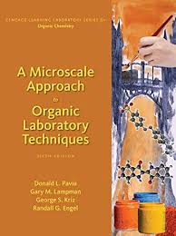
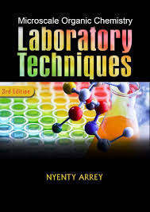
H. Implement a “green” curriculum: Green Chemistry for Every Laboratory
Waste Reduction/Prevention: Design of micro-scale experiments

Slide 37
ACKNOWLEDGMENT:
DR. ANN P. VILLALOBOS
Research Fellow & Consultant, Janssen Pharmaceuticals
Research company of
Johnson & Johnson Company (USA)
ENGR. EMMIE G. REYES
ASEAN Engineer
College of Engineering,
Central Mindanao university,
Bukidnon,
Philippines
EPA. 2008. Building a successful program to address chemical risks in school: A Workbook with Templates, Tips and Techniques. http://www.epa.gov/sc3
EPA. 2006. Chemical Resource Management Guide for School Administrators.
National Research Council. (2011). Prudent practices in the laboratory: handling and management of chemical hazards, updated version. National Academies Press.

