Slide 1
Scientific and Technological Developments in Biology and their Impact on the Prohibition of BW
Tim Trevan
Chrome Consulting
Doha, Qatar, 30 March 2016

Slide 2
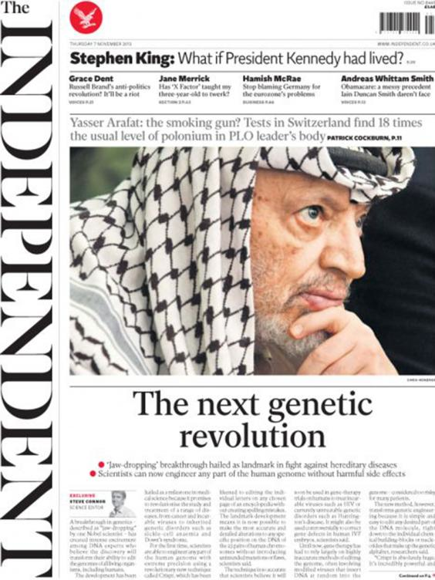
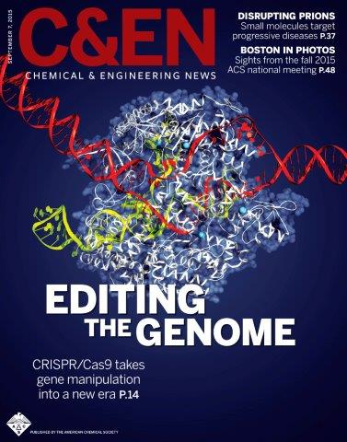

Slide 3
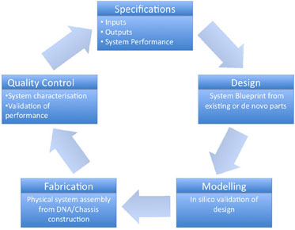
What is Synthetic Biology?
Many definitions.
An engineering approach to biology:
Design for purpose
Standardization of parts
Defined tolerances
Novel forms or new metabolic pathways

Slide 4
Synthetic Biology Designing for Purpose
To design for purpose implies knowledge of:
Genomics:
What genes do individually and in combination
Reliant on information technology and GWAS (genome-wide association studies)
Genes synthesis
Genome engineering (systems biology and its components, knock outs/ins)
Standard components and tools – c.f. nuts and bolts, spanners and wrenches
Optimization – ‘organism fine-tuning’
Chasses (minimal-genome organisms into which one inserts desired genetic material)
Promoters, gene switches, sRNAs (small RNAs regulate gene expression)
Health of the organism: energy compromise

Slide 5
Synthetic Biology Enabling Technologies*
Practitioners engaged in synthetic biology research listed these technologies as enabling the engineering of biological systems:
public and private registries of biological parts
standard methods for physical assembly of DNA constructs
genomic databases
software tools for search, alignment, analysis, and editing of DNA sequences, and
commercial services for DNA synthesis and sequencing.
Also, but less widely used:
Standards and methods supporting measurement, functional composition, and data exchange
* http://www.jbioleng.org/content/7/1/13: Kahl and Endy

Slide 6
Synthetic Biology Enabling Technologies*
European perspective from EMBO:
Genome Editing
Modelling and Computer-Aided Design
Bio-bricks and Synthetic Circuits
Synthetic Cells
Systems Biology
Metabolic Engineering
* http://www.embo-embl-symposia.org/symposia/2015/EES15-04/ Fussenegger, Nielsen, Smolke, Patil

Slide 7
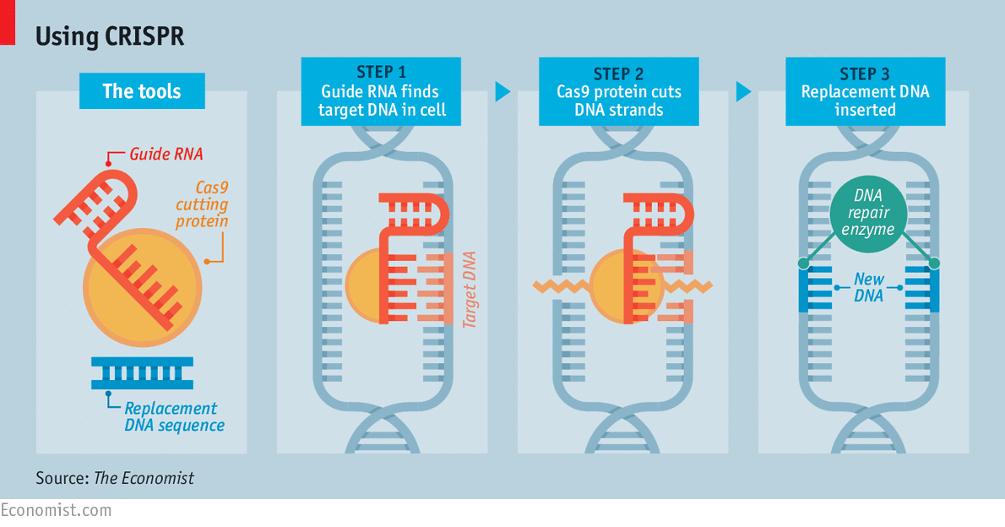

Slide 8
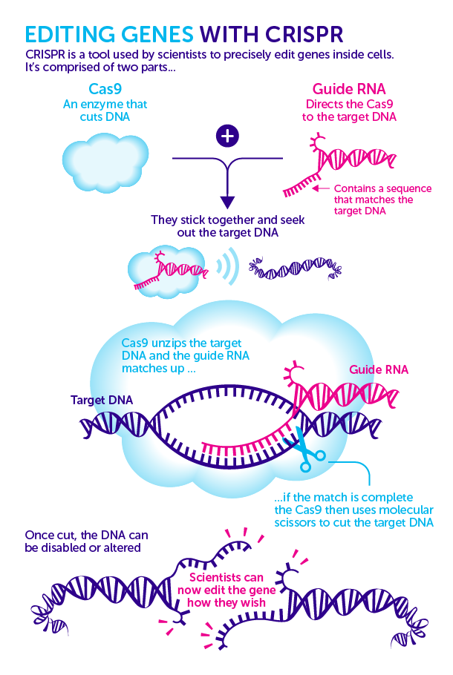

Slide 9
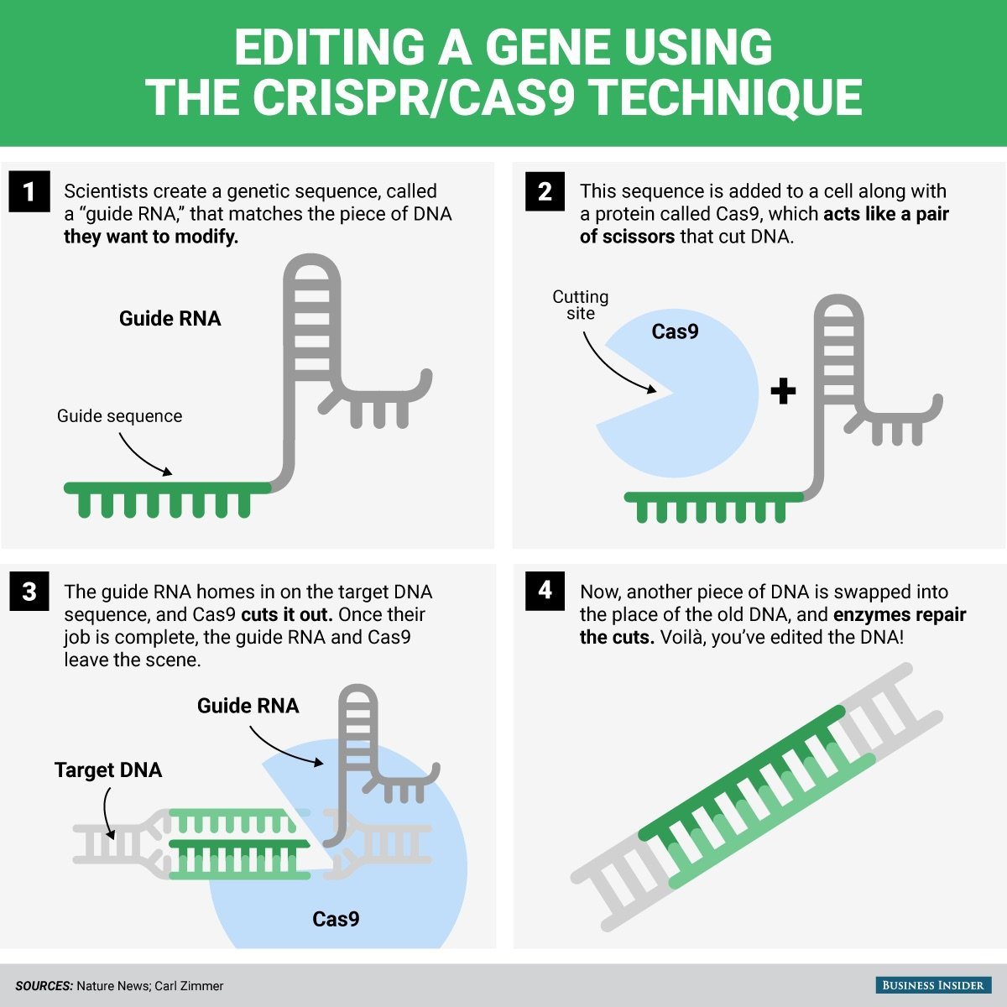

Slide 10
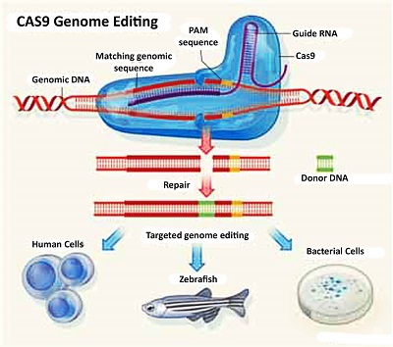

Slide 11
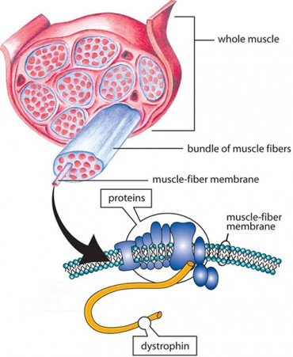
CRISPR Used to Correct Defective Gene in Duchenne Muscular Dystrophy

Slide 12
Why does this matter to the BWC?

Slide 13
Why does this matter to the BWC? The belief that if you have the tools to make something, you can make something Comparisons with software hacking

Slide 14
Overview
Biology as computing
Reading DNA
Writing DNA
Designing DNA
Gene Editing
Distribution of Means
SynBio knowledge
Genome data
Technology
Equipment
Impact on arms control and non-proliferation

Slide 15
Biology as computing - basic
Cell Code
(DNA)
Cell hardware
(ribosome)
Output
(peptide)
Computer Code
(software)
Cell hardware
(CPU)
Output
(eg spreadsheet)

Slide 16
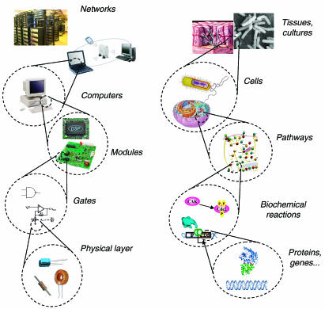
Biology as computing - networks

Slide 17
The Concern
As we learn about genomics, we can think about designing biology
Reading genomes is getting quicker, cheaper and easier
Big Data and computing power means extracting knowledge from data is becoming easier on a bigger scale and for harder issues
Writing DNA and genomes is getting easier – software and printing
Viral DNA can be ‘sent’ over the internet
Equipment for writing DNA is getting smaller and cheaper
All the equipment and knowledge has legitimate uses which cannot ethically be denied through export controls
The Dark Web is rendering export controls less effective
SENDING PATHOGENIC GENE SEQUENCES OVER THE WEB FOR SYNTHESIS OF EXISTING OR NEW PATHOGENS FOR BIOLOGICAL WEAPONS PURPOSES MAY BECOME A REALITY

Slide 18
Reading DNA

Slide 21
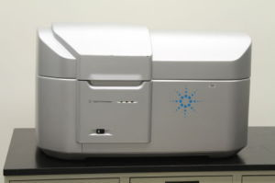
AGILENT G2505A DNA Sequencer $1,969.00 USD
www.dotmed.com

Slide 22
Writing DNA

Slide 23
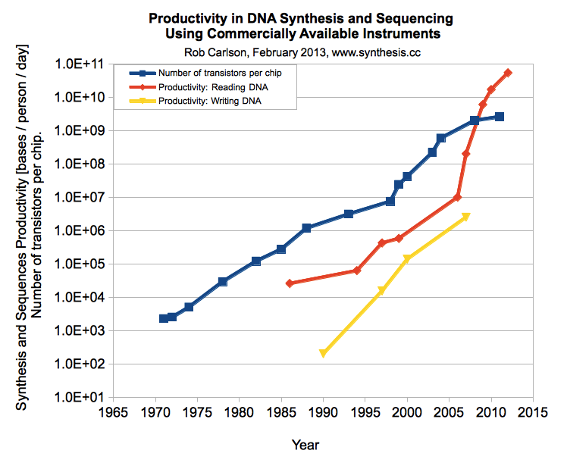

Slide 24
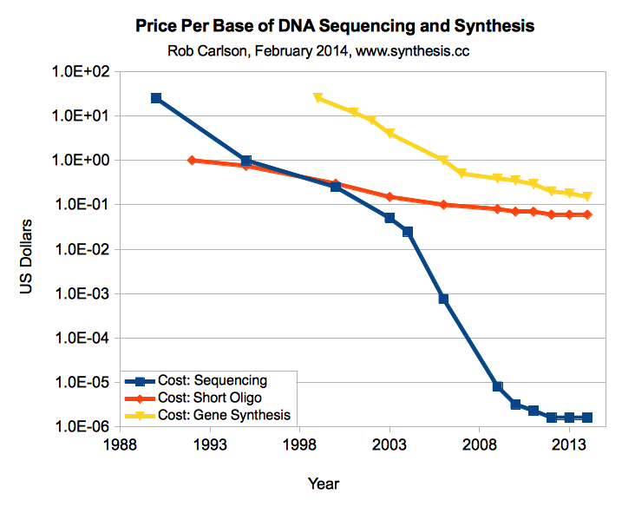

Slide 25
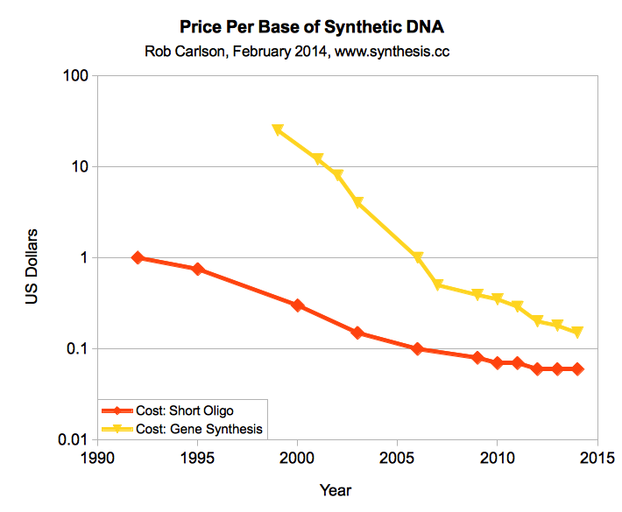

Slide 26
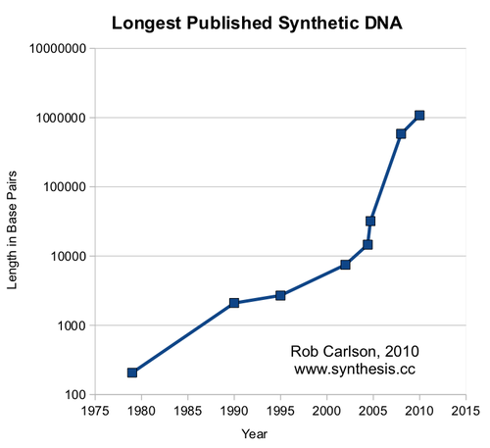

Slide 27
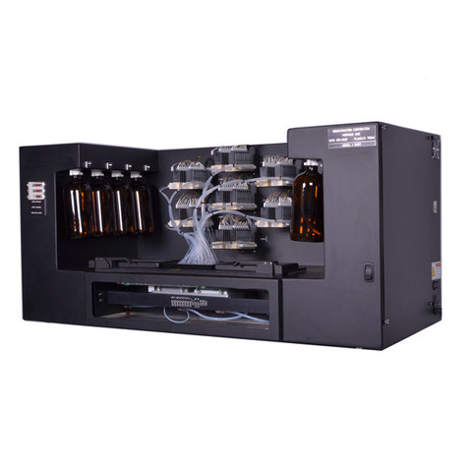
BioAutomation MerMade 192E Oligonucleotide synthesizer is designed to synthesize DNA, RNA & LNA oligonucleotides in a column format using standard or modified chemistries.

Slide 28
Designing DNA
Software to design DNA
Software to design metabolic pathways and identify genes needed

Slide 29
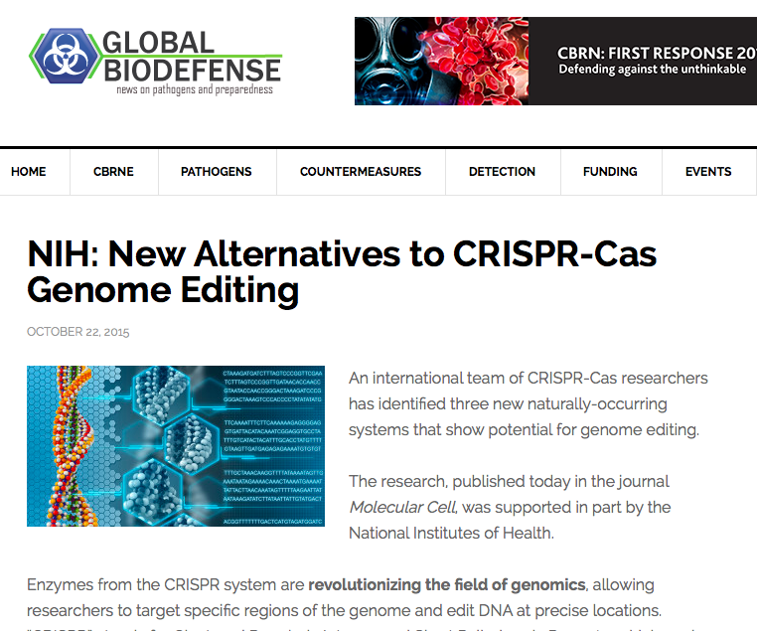
Genome Editing
Agrobacter
Hybrid meganuclease
Zinc Finger Domains
Talen
Gene Guns
CRISPR-Cas9
New methods
Gene Drives
Easier, quicker, cheaper, more accurate, fewer errors

Slide 30
Issues with the Biology as Computing Analogy
Computers are dry
Computers are designed
Computers draw the power they need
Computers can focus on one designed task
Biology is wet
Biology evolved
Biology is living so must be energy efficient
Synthetic organisms must do three:
Living
Reproducing
Designed production

Slide 31
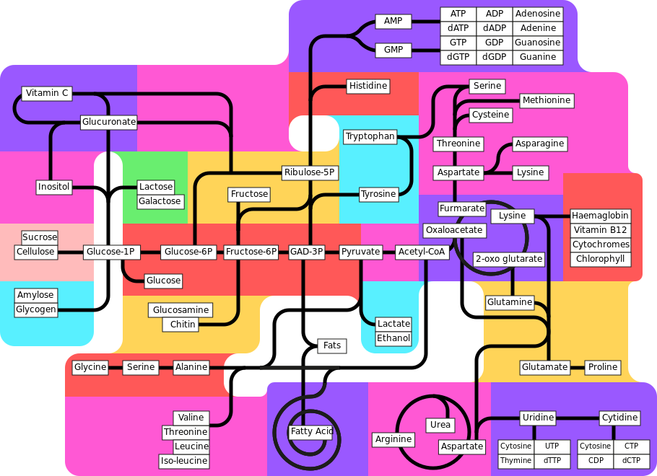

Slide 32
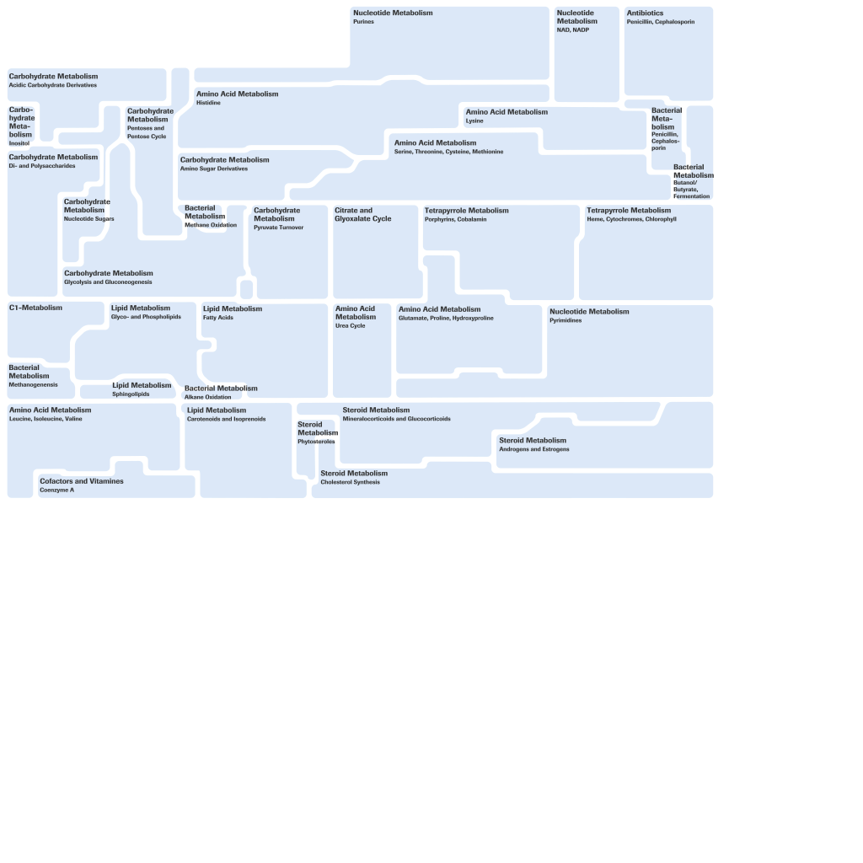
http://biochemical-pathways.com/#/map/1

Slide 35
Implications for Arms Control
Size of biological weapons R&D complex and number of persons required reduced (?)
Smaller footprint makes it easier to keep programmes clandestine
Dual-use nature of research, materials, expertise and equipment (at least re development of viable BW agents)
Weaponisation – wmd vs terror vs assassination

Slide 36
Implications for Non-Proliferation
Practicality of export controls on data
No need to export pathogens
Availability of equipment (and some expertise) online, potential to avoid export controls and surveillance
Undeniable need for same technologies and equipment to tackle urgent and vital social, health, economic and environmental issues

Slide 37
The Regulatory Mix
Coercive
based on the authority of the state and accompanied by penalties for noncompliance; eg statutory regulations, reporting requirements, and mandatory licensing, certification and registration
Normative
based on conceptions of what is socially desirable; eg professional self-governance, codes of practice, guidelines, and transparency measures
Source: Lentzos, 2012
Mimetic
based on enlightened self-interest; eg successful practices and models of behaviour such as national and international standards (ISO), education and awareness-raising

Slide 38
The New Biological Security
Impracticability of ‘verification’
Cannot stand over the shoulder of every scientist using genetic engineering techniques
Export controls redundant?
Rise of the ‘insider threat’ and ‘lone wolf’
Greater emphasis on:
intelligence and interdiction
culture of safety and security/self-governance

Slide 39
The Good News
Knowledge of pathogenicity and transmissibility currently insufficent for design-for-function
Pleiotropy
Evolving out inserts
Evolving to lower mortality and morbidity with higher transmissibility
We have some time to get ready

Slide 40
Thank you!
timtrevan@biosafety.co
Chrome Biosafety and Biosecurity Consulting
www.biosafety.co

